Slide 1
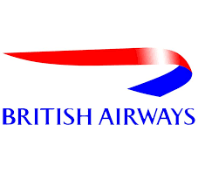
BRITISH AIRWAYS
FOR THE PURPOSE OF FORAGE JOB SIMULATION
CUSTOMER REVIEWS ANALYSIS

Slide 2
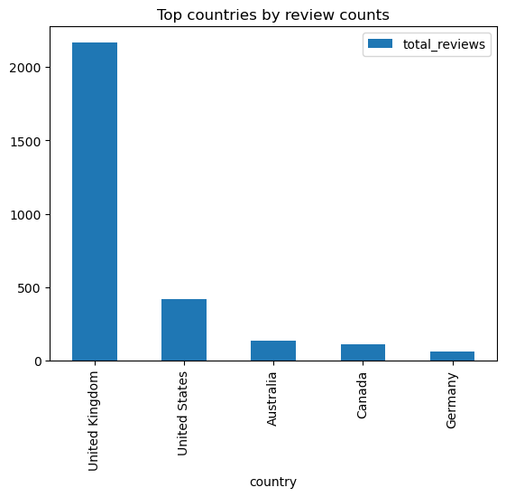
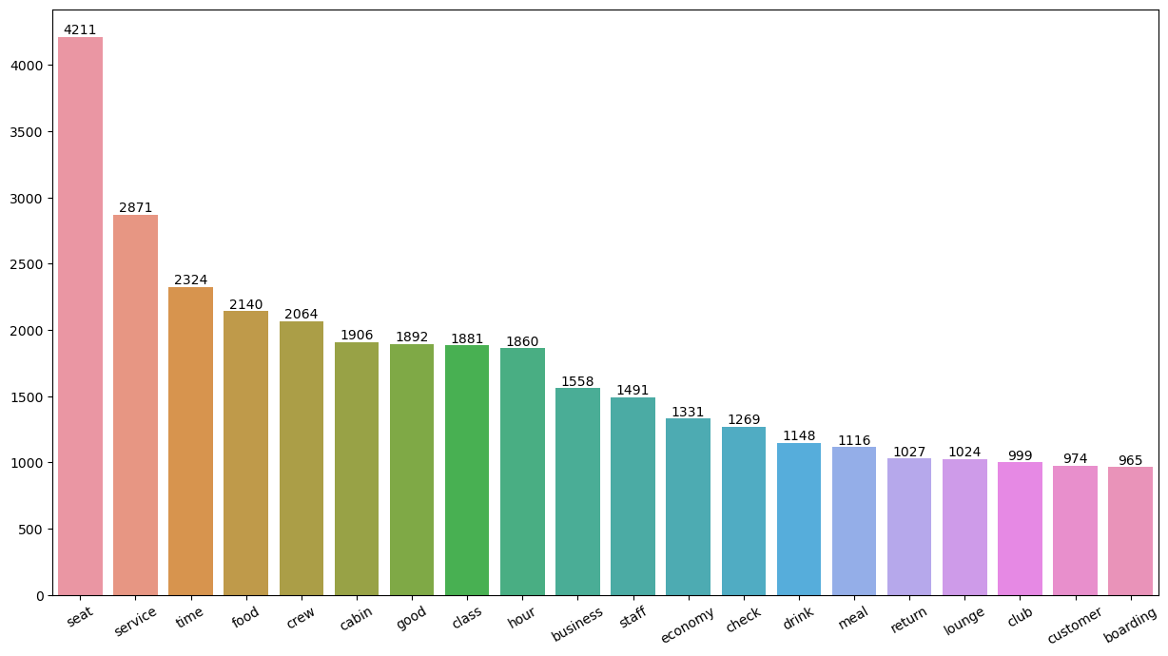
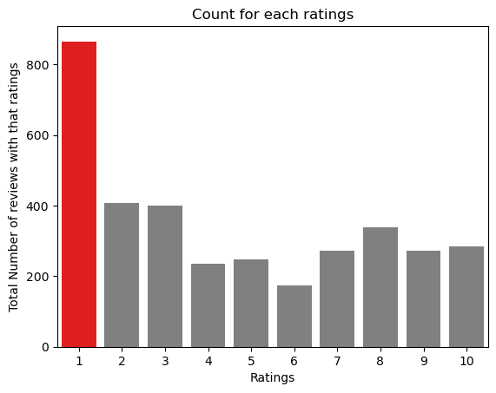
KEY INSIGHTS
UNIQUE COUNTRIES
TOTAL REVIEWS COLLECTED
AVG RATINGS
4.7/10
70
3496
Most of customers like the cabin crew services and good quality food.
Most talked subject either positively aur negatively is about seats.
Improvements : Economy class service and seats, in flight entertainment and delays. Business class experience could be enhanced cause people like value for their money.
Customers Revies depending on the rating:-
Review that are rated between 7-10 talked about comfortable seats, friendly crew and good food and drink.
Review that are rated between 4-6 faced problem with business class, customer service and long checking time.
Review that are rated between 1-3 were dissatisfied with small tv screen, long meal service while the food was good.

